Slide 1
Unit 3 Disributed Deadlock detection and Agreement protocols

Slide 2
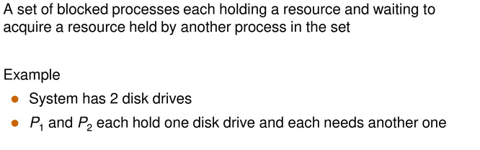
Deadlock
Deadlock is a situation where a set of processes are blocked because each process is holding a resource and waiting for another resource acquired by some other resource.

Slide 3
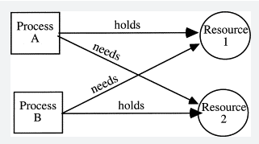
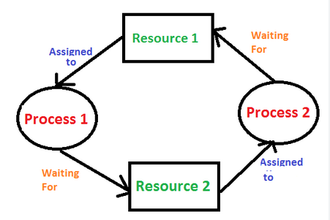

Slide 4
Methods for handling deadlock/Deadlock Handling strategies 1 Deadlock Prevention
2 Deadlock Avoidance
3 Deadlock Detection

Slide 5
1. Deadlock Prevention
Deadlock can arise if four conditions hold simultaneously
Mutual Exclusion
Hold and Wait
No Pre-emption
Circular Wait

Slide 6
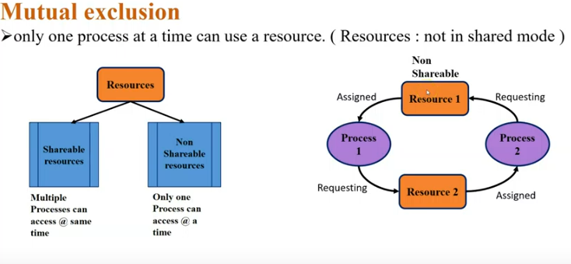

Slide 7
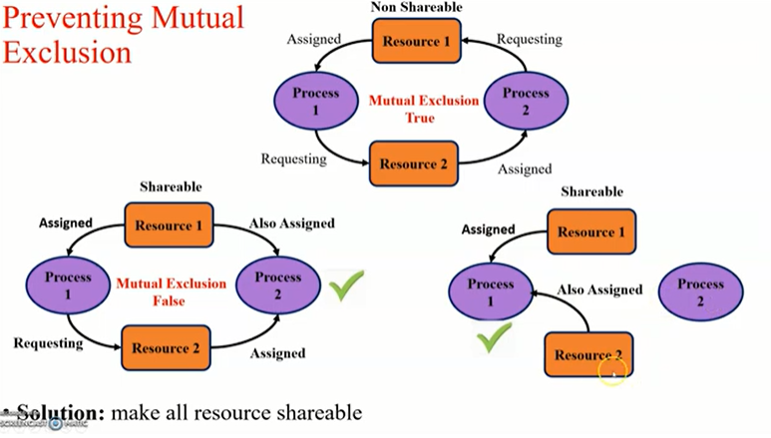

Slide 8
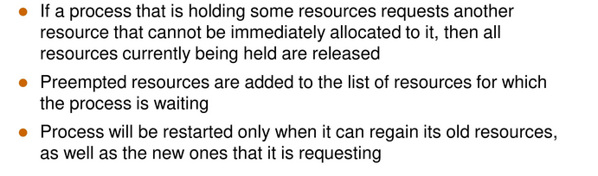
No Pre-emption

Slide 9
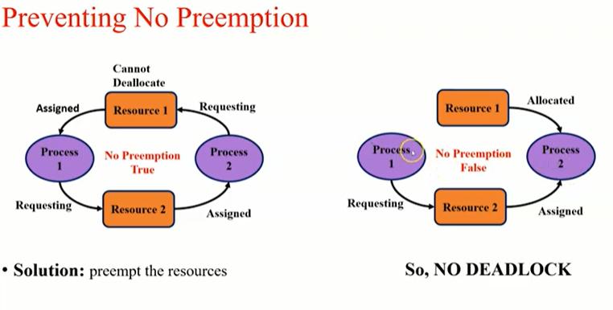

Slide 10
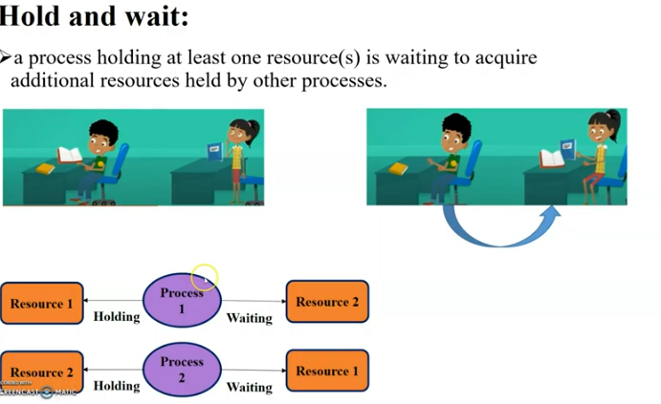
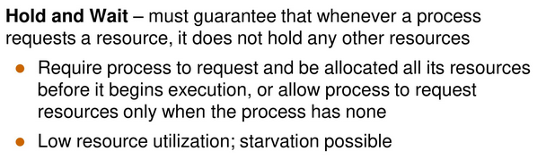
Hold and wait A process waits for some resources while holding another resource at same time

Slide 11
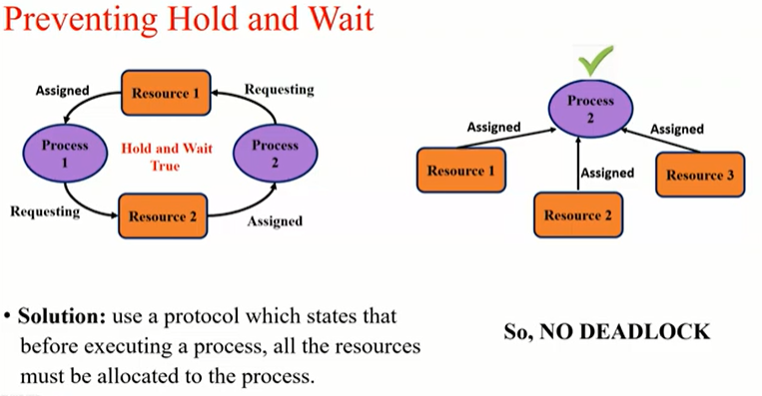

Slide 12
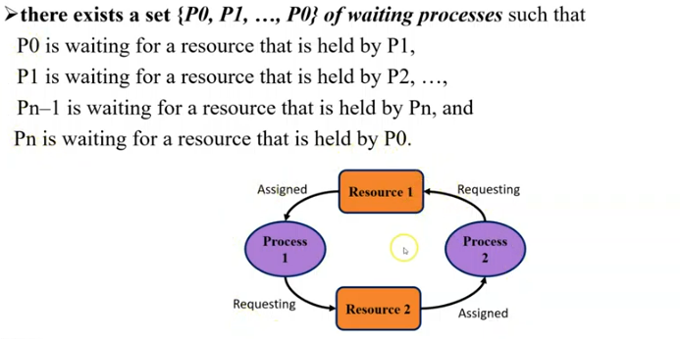
Circular wait All the processes must be waiting for the resources in a cyclic manner

Slide 13
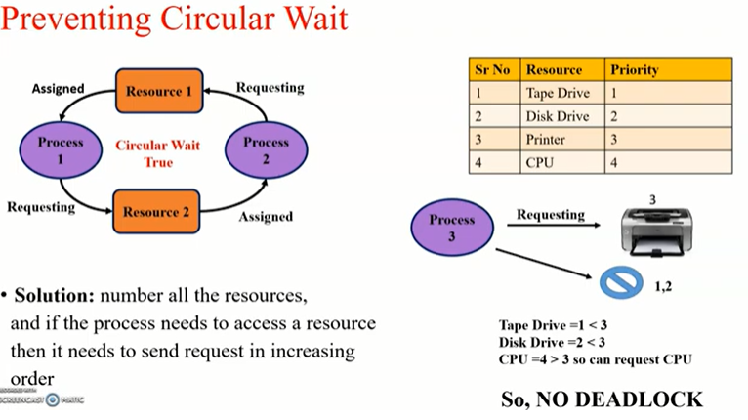

Slide 14
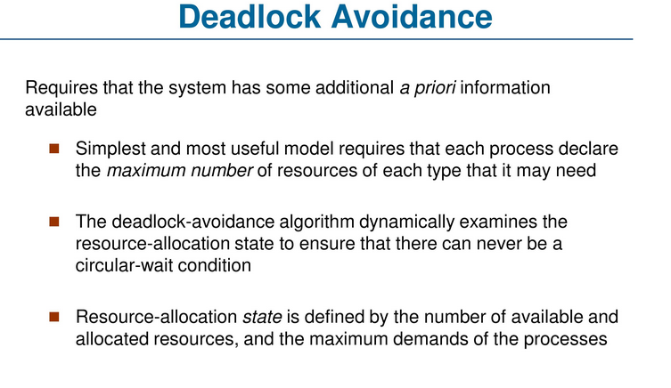
2. Deadlock Avoidance

Slide 15
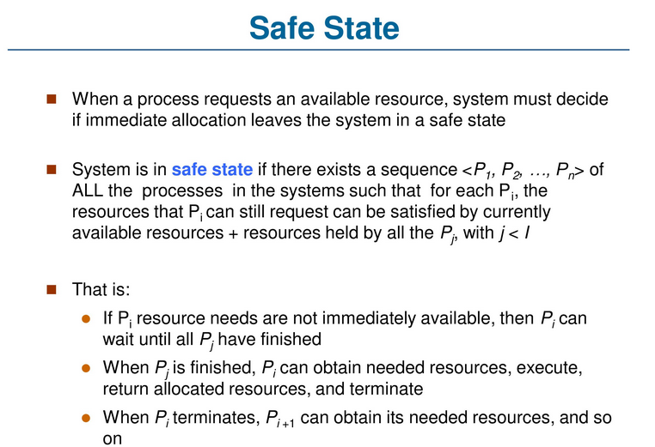

Slide 16
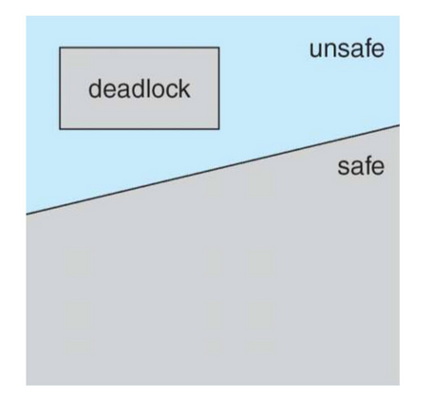
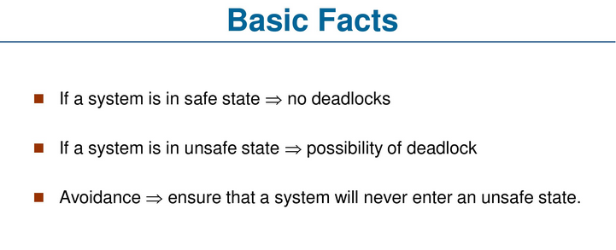

Slide 17
3. Deadlock detection and recovery
In this strategy, deadlock is detected and an attempt is made to resolve the deadlock state of the system. These approaches rely on a Wait-For-Graph (WFG), which is generated and evaluated for cycles in some methods. The following two requirements must be met by a deadlock detection algorithm:
Progress: In a given period, the algorithm must find all existing deadlocks. There should be no deadlock existing in the system which is undetected under this condition. To put it another way, after all, wait-for dependencies for a deadlock have arisen, the algorithm should not wait for any additional events to detect the deadlock.
No False Deadlocks: Deadlocks that do not exist should not be reported by the algorithm which is called phantom or false deadlocks.

Slide 18
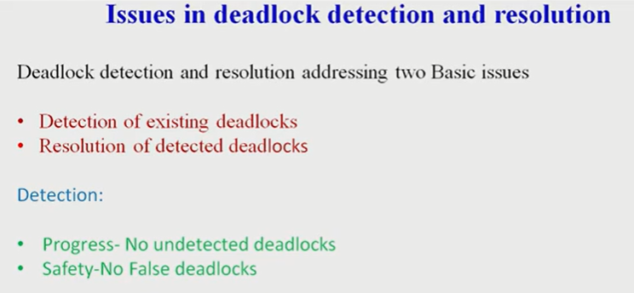
Issues in deadlock detection

Slide 19
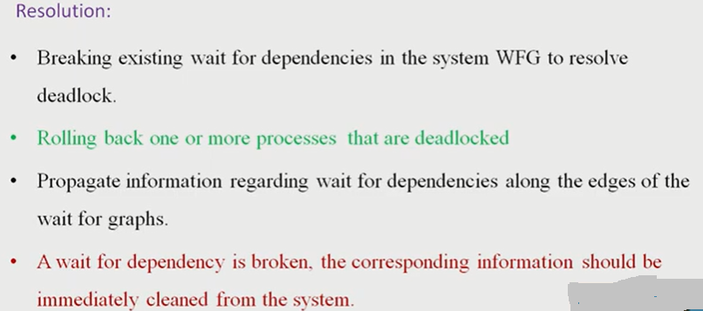
Resolution of deadlock detection

Slide 20
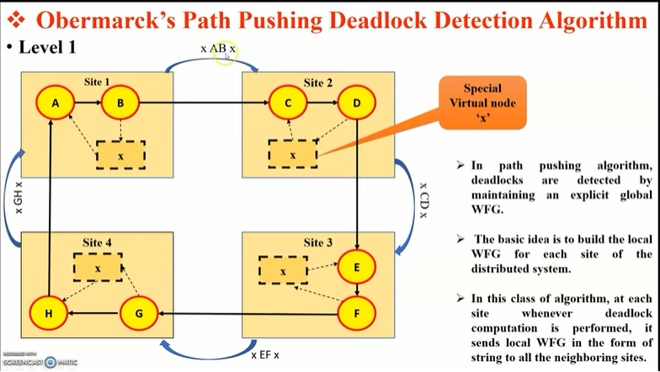
Path pushing algorithm

Slide 21
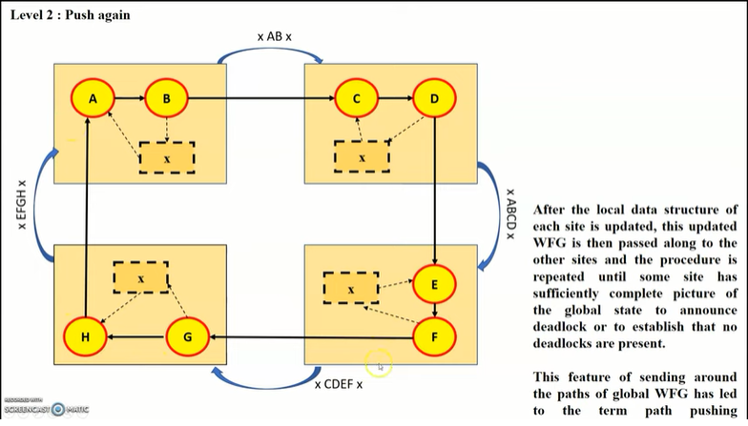

Slide 22
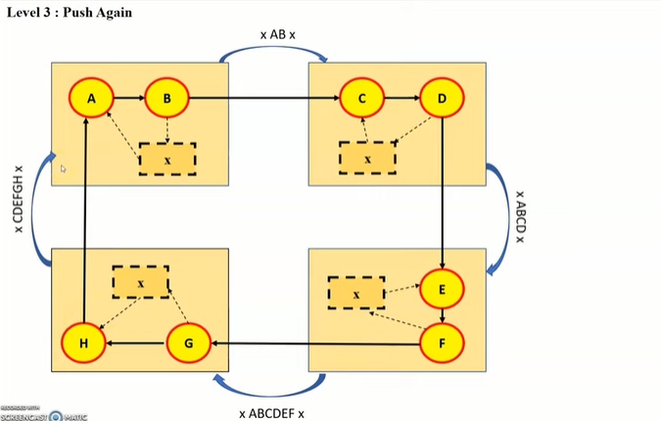

Slide 23
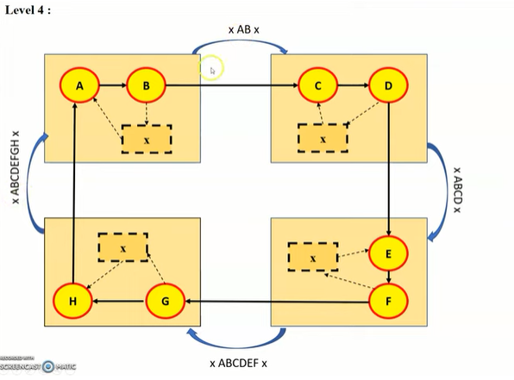

Slide 24
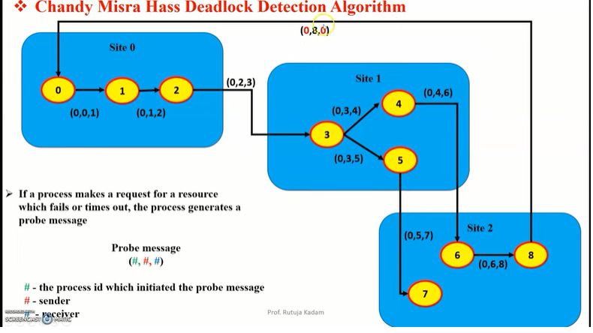
Chandy Misra hass distributed deadlock detection algorithm

Slide 25
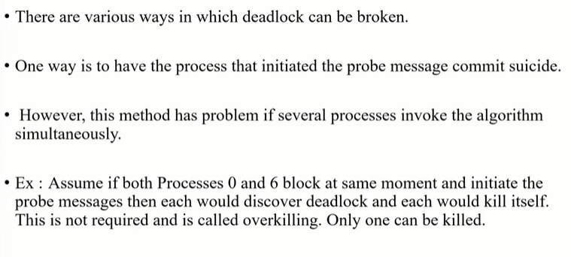

Slide 26
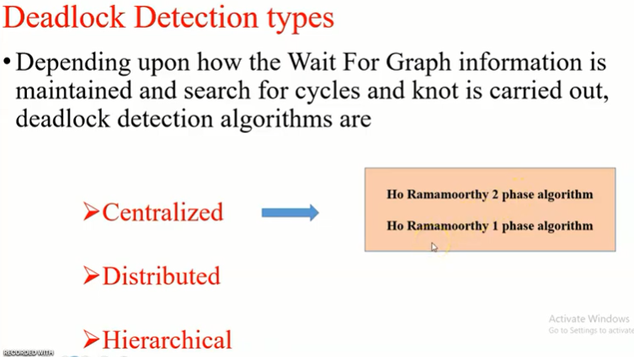

Slide 27
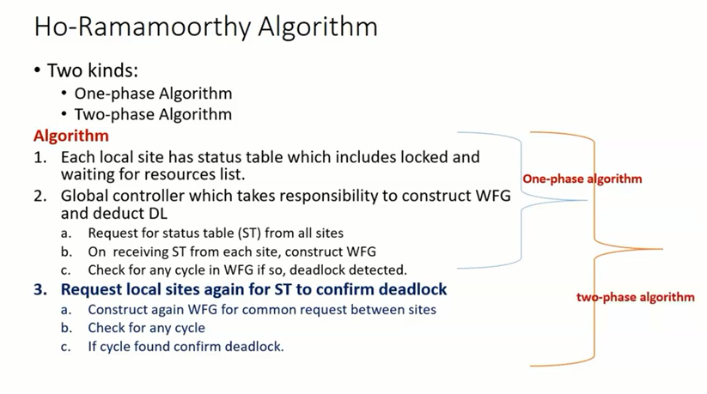

Slide 28
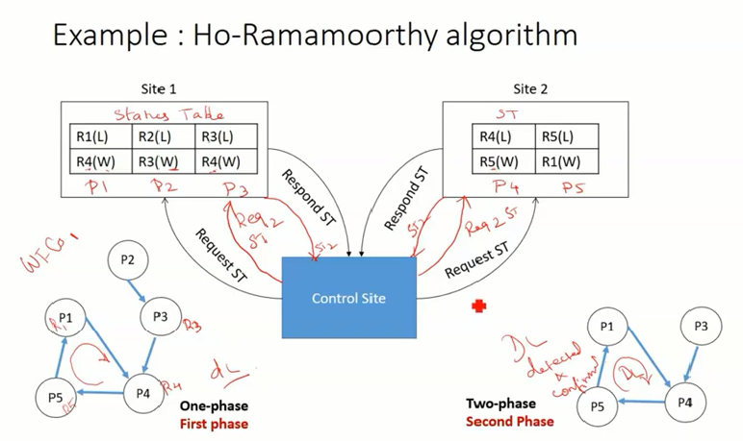

Slide 29
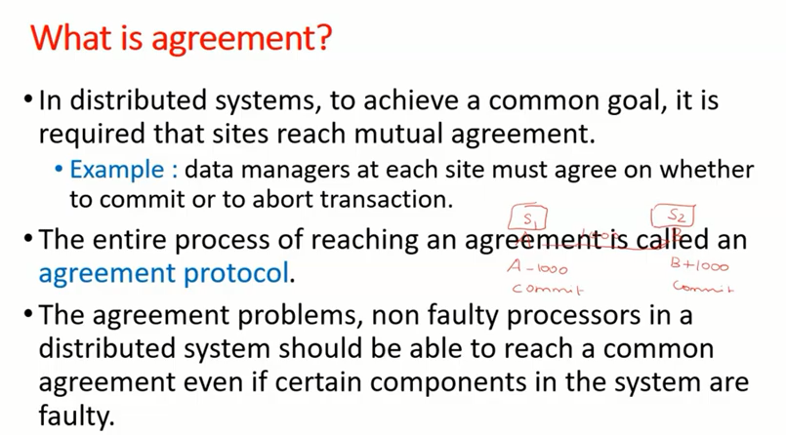
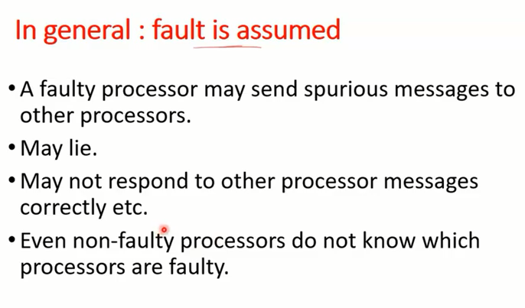
Agreement protocols

Slide 30
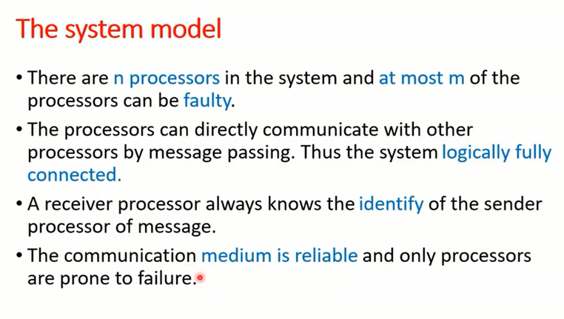
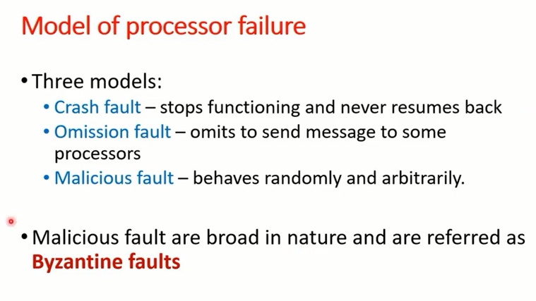

Slide 31
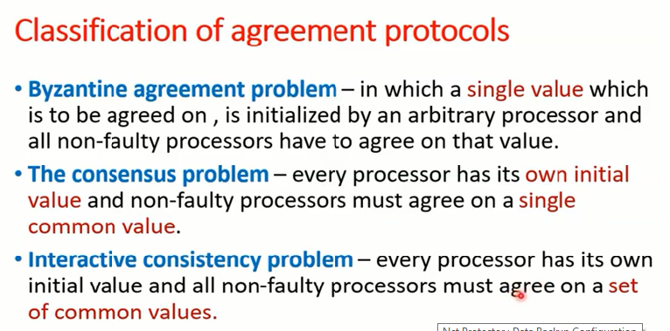

Slide 32
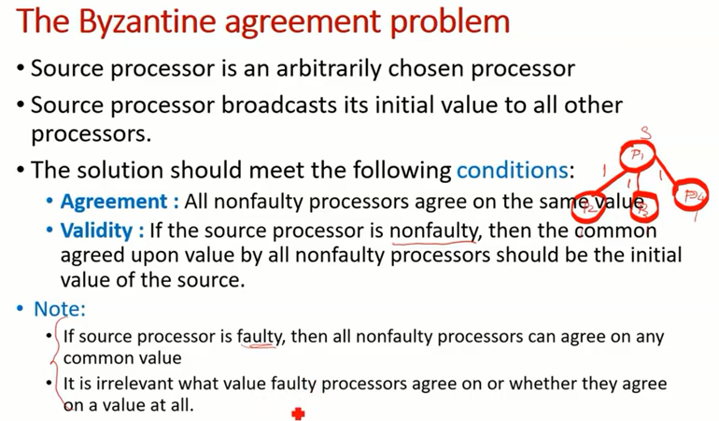

Slide 33
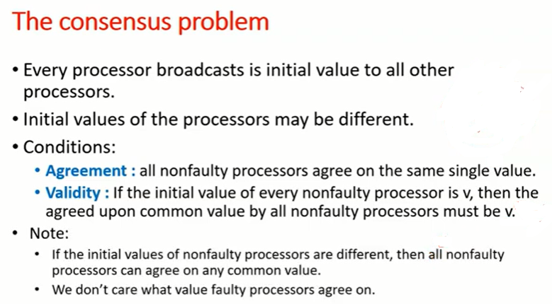

Slide 34
